Slide 1



V2P: Vision-to-Prompt based Multi-Modal Product Summary Generation
Xuemeng Song†, Liqiang Jing†, Dengtian Lin†,
Zhongzhou Zhao§, Haiqing Chen§, Liqiang Nie†
†Shandong University, Shandong, China,
§Alibaba Group, Hangzhou, China
Presenter: Liqiang Jing
jingliqiang6@gmail.com
Notes:
Hello, everyone, I’m Liqiang Jing, a second-year postgraduate student from Shandong University of China. It is my pleasure to present our work “V2P: Vision-to-Prompt based Multi-Modal Product Summary Generation”.

Slide 2
Outline
Background
Limitations
Experiment
Related Work
Method
Notes:
I will introduce our work from the following aspects.

Slide 3
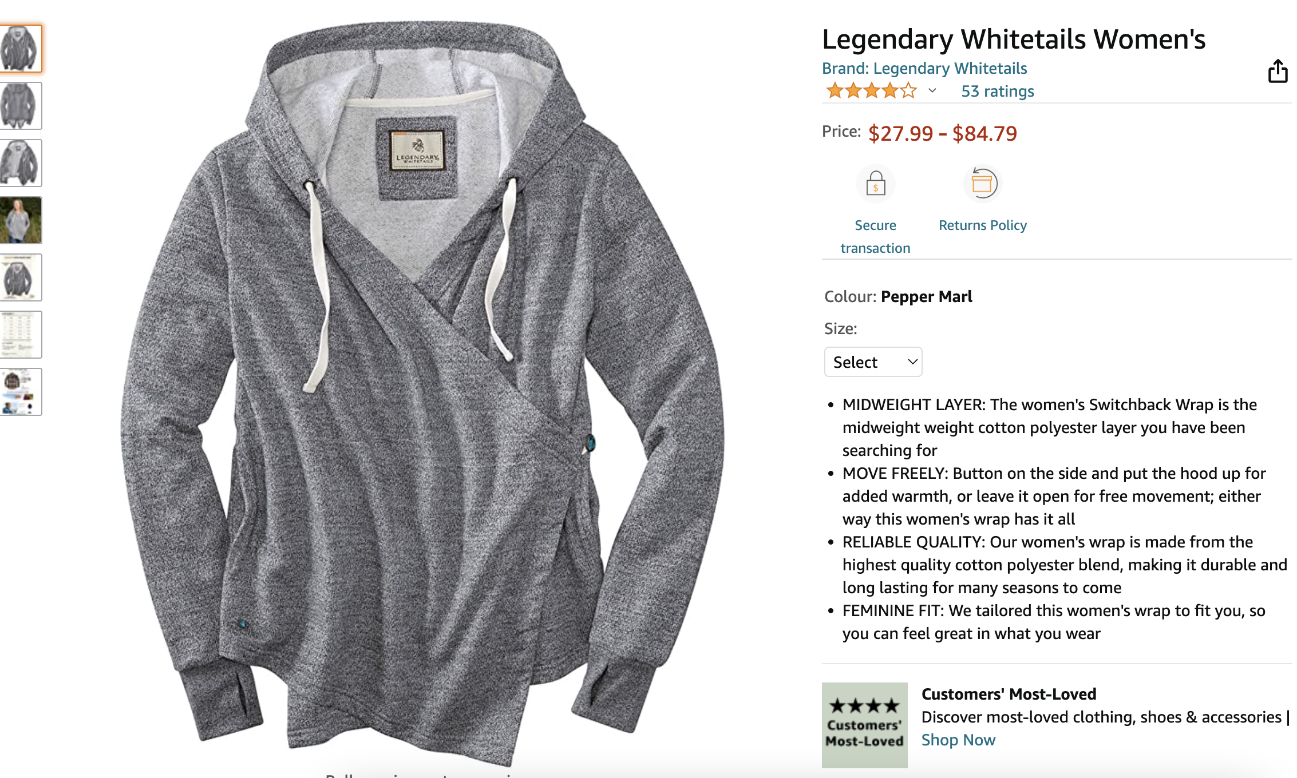
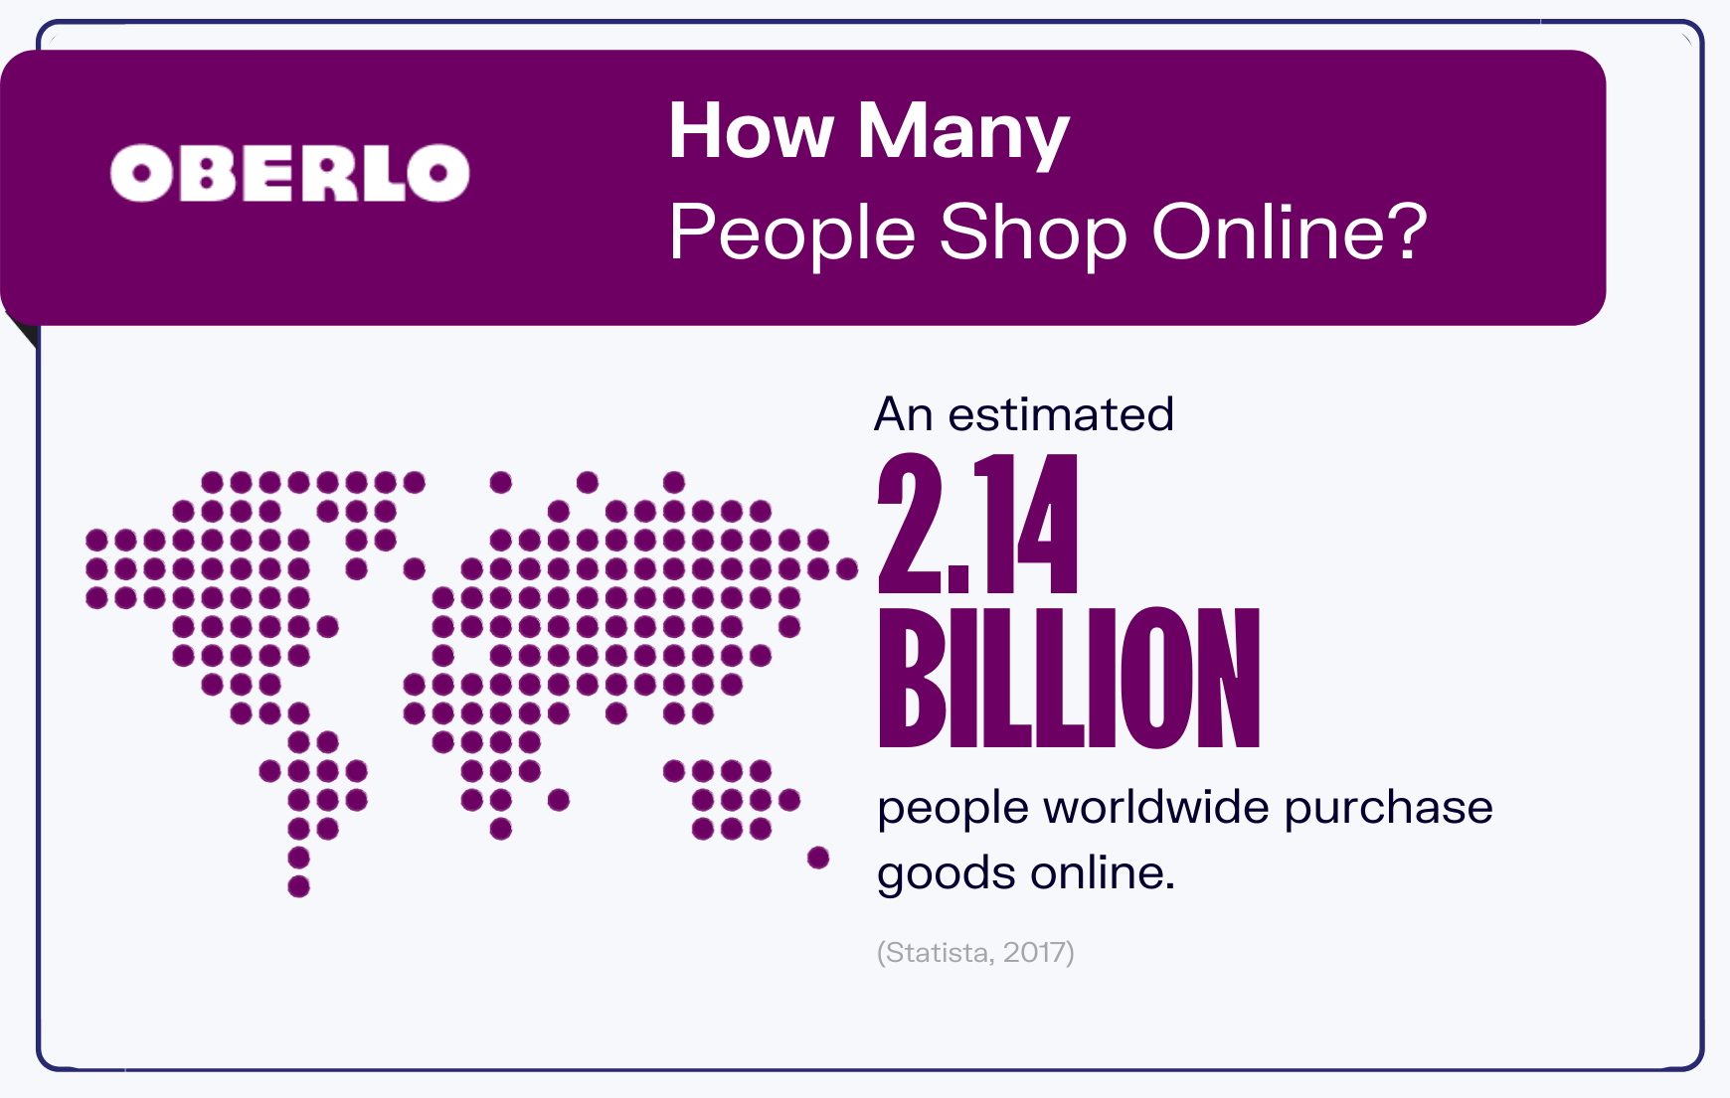
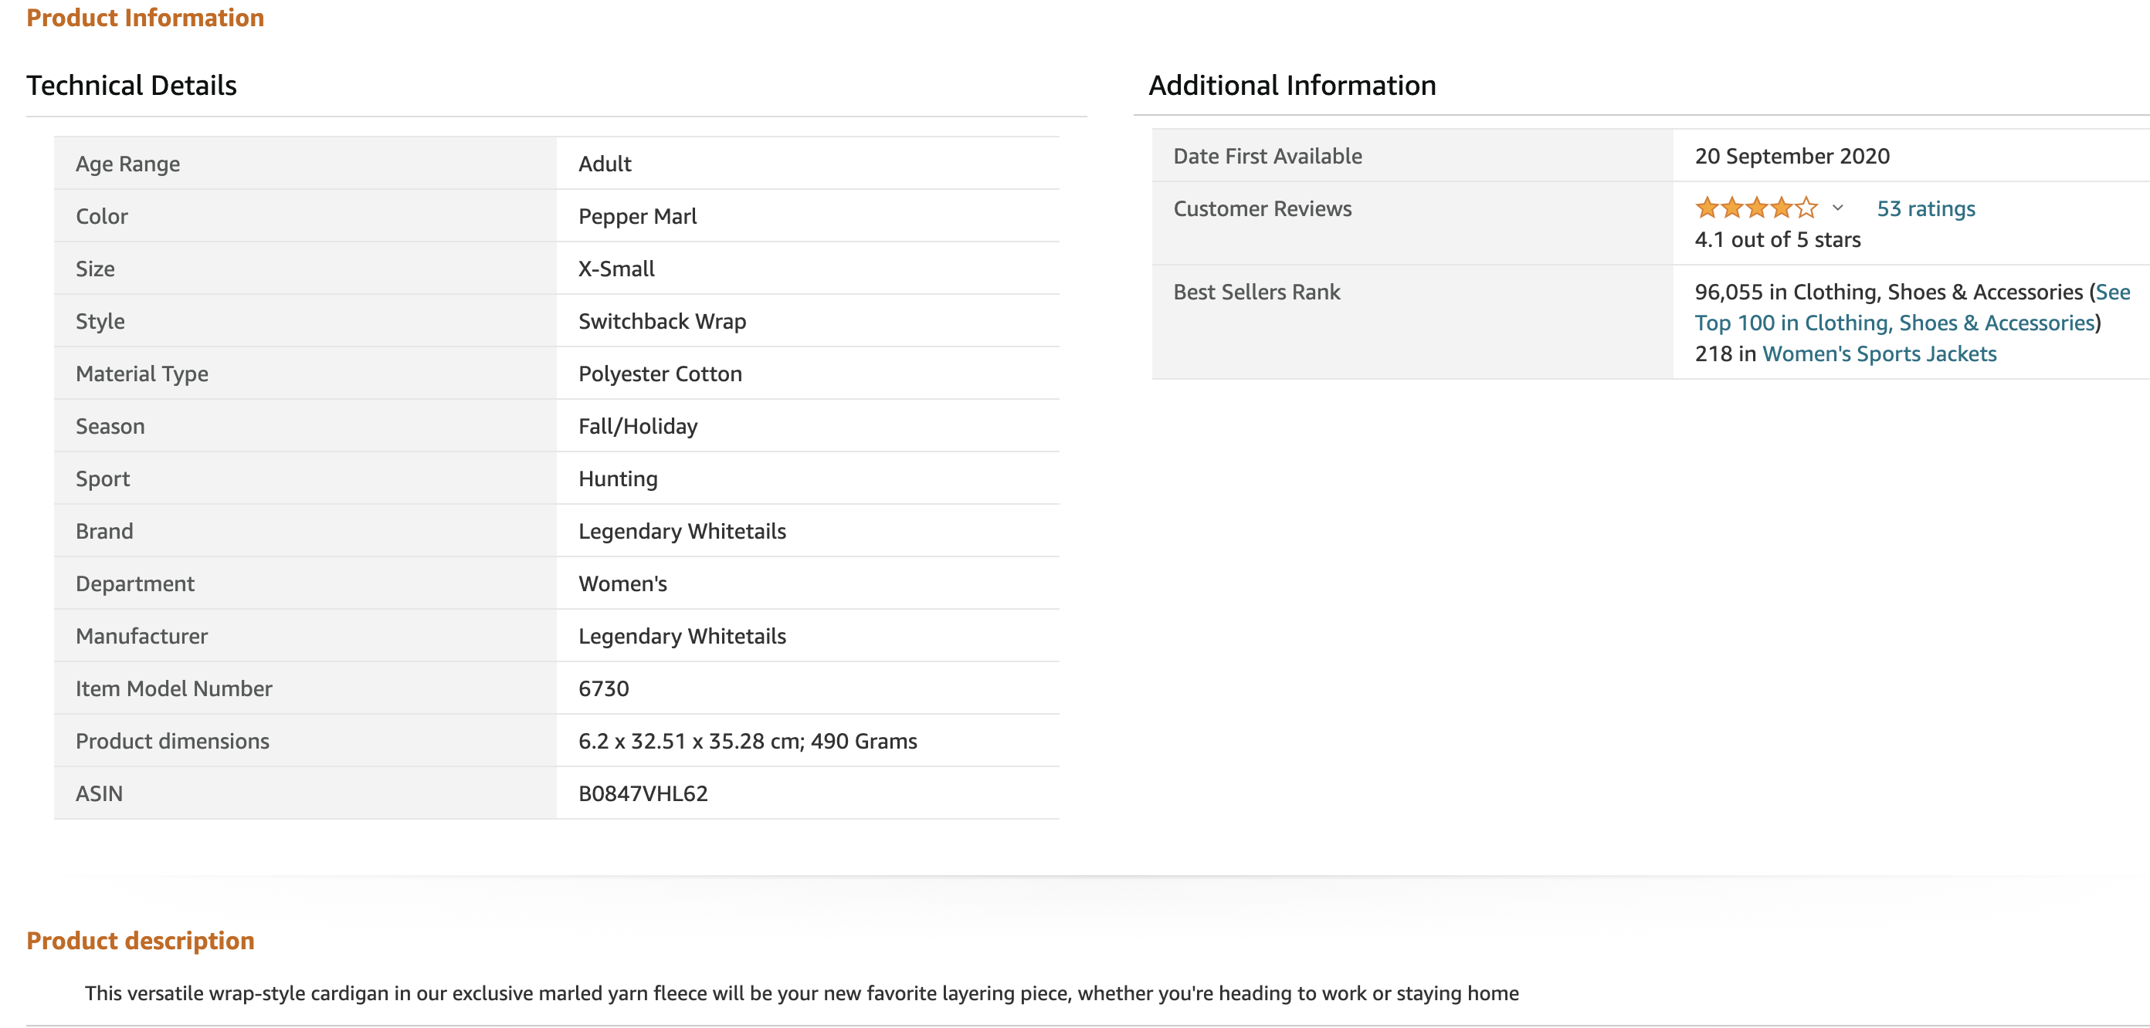
Background
Online shopping platform always shows various information about the product.
https://www.oberlo.com/blog/online-shopping-statistics
Notes:
First, let’s start with a brief introduction.
In recent years, owing to the convenience of online shopping, more and more people tend to buy their favorite goods on online shopping platforms, such as Amazon and Taobao. The number of online shoppers worldwide reached 2.14 billion in 2017.
ˈæməzɑːn
On online shopping platforms, there is so much information about the product, such as color, image, and quality. In a sense, this makes it hard for shoppers to judge whether the product meets their purchase needs.

Slide 4
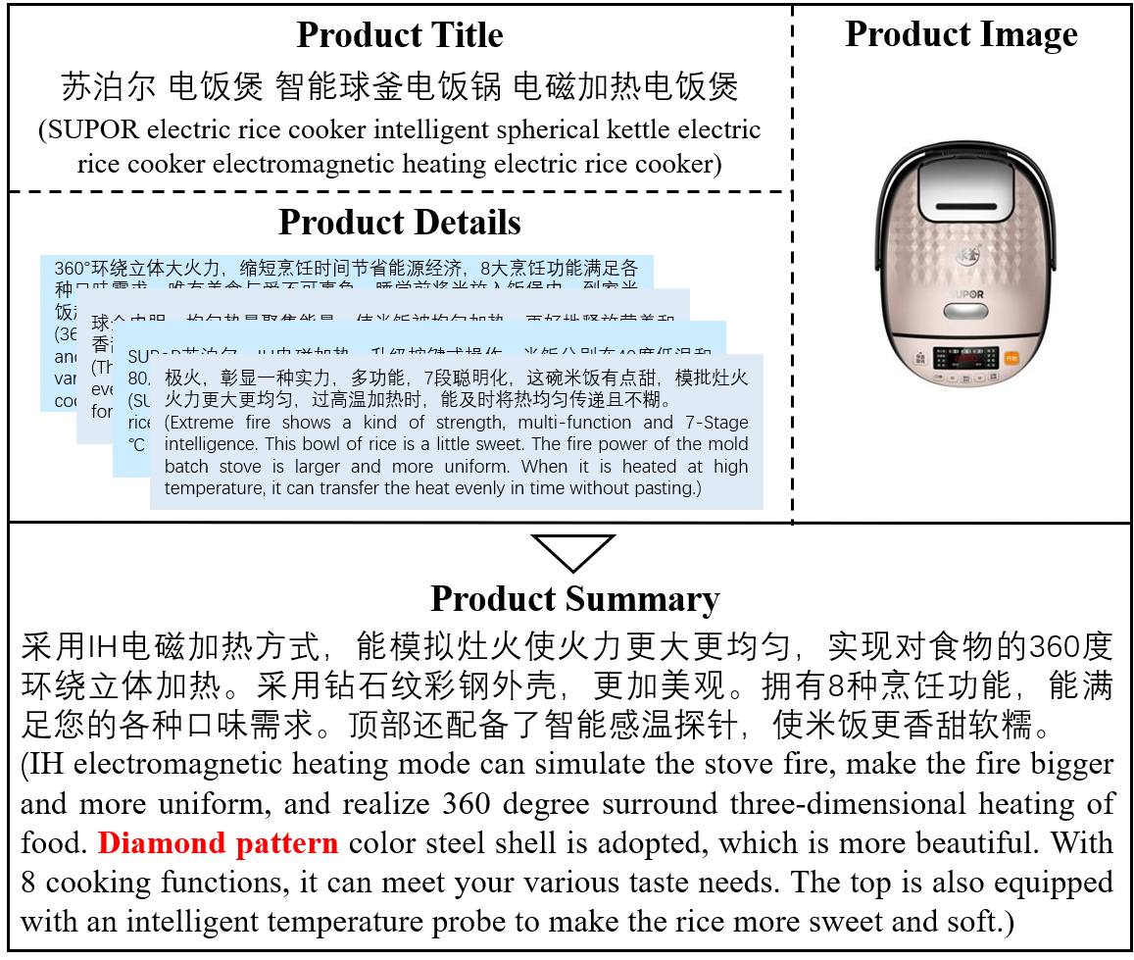
Background
Multi-Modal Product Summarization Generation (MPSG)
Notes:
Therefore, it is highly desired that the seller can provide a concise product summary to highlight the product characteristics.
kənˈsaɪs kærəktə'rɪstɪks ˈsʌməriz ˌekspɜːrˈtiːz
Meanwhile, writing concise summaries for products needs certain expertise.
In light of this, automatic product summary generation gains increasing research attention.

Slide 5
Outline
Background
Limitations
Experiment
Related Work
Method
Notes:
In fact, some researchers have made progress on this task.

Slide 6
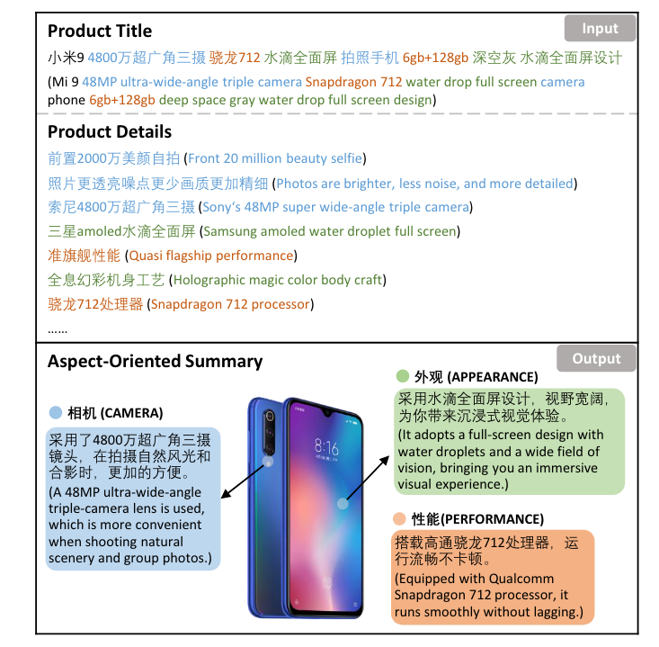
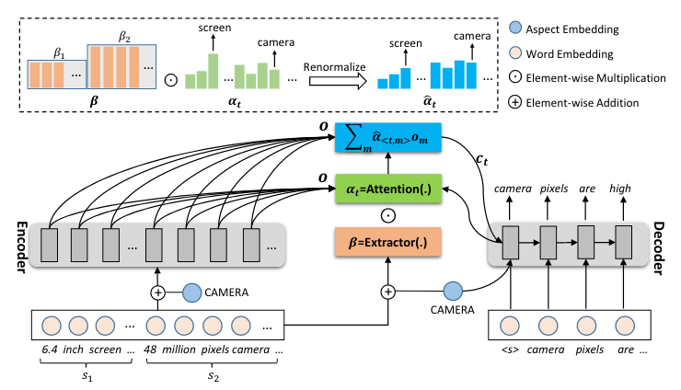
Related Work
Traditional Product Summarization
Jiahui Liang et al. CUSTOM: Aspect-Oriented Product Summarization for E-Commerce. NLPCC. 2021.
Notes:
E-commerce product summarization aims to generate a concise, short, and readable text that contains the most salient information for a product, to save consumers’ time and improve their consumption experience.
seɪliənt kənˈsuːmərz kənˈsʌmpʃn ɪkˈspɪriəns
Early researches mainly focus on generating the product summary based on the product’s textual descriptions. These methods ignore the product’s image, which also delivers important cues regarding the product characteristics and benefits the product summarization.
ˈbenɪfɪts kjuːz

Slide 7
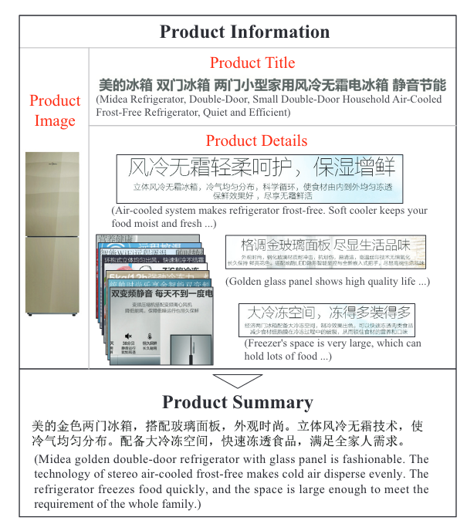
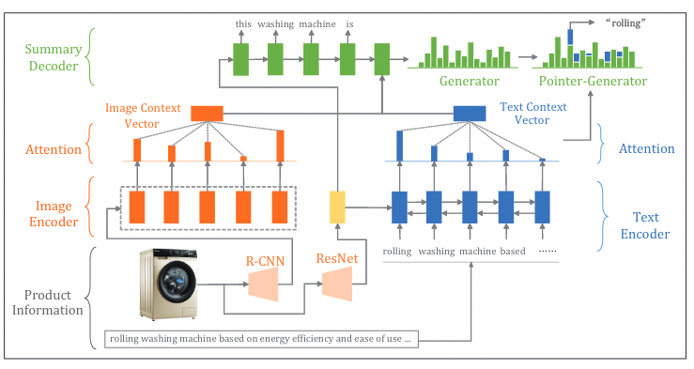
Related Work
Multi-Modal Product Summarization
Haoran Li et al. Aspect-Aware Multimodal Summarization for Chinese E-Commerce Products. AAAI. 2020.
Notes:
Therefore, a few pioneer studies resorted to the Multi-modal Product Summary Generation.
ˌpaɪəˈnɪr

Slide 8
Outline
Background
Limitations
Experiment
Related Work
Method
Notes:
Although the pioneer studies have achieved significant progress, they mainly suffer from three key limitations.
sɪɡˈnɪfɪkənt

Slide 9
Limitations
L1: Overlook the benefit of pre-training.
L2: Lack the representation-level supervision.
L3: Ignore the diversity of the seller-generated data.
Notes:
Previous methods follow the conventional train-from-scratch paradigm and fail to take advantage of the pre-training technique, especially the powerful text generation capability of Generative Pre-trained Language Models (GPLMs), which have shown compelling success in various natural language generation tasks.
kənˈvenʃənl ˌkeɪpəˈbɪləti skrætʃ ˈpærədaɪm kəmˈpelɪŋ ˈveriəs
Existing methods mainly focus on the overall output-level supervision, in other words, they utilized the cross-entropy loss to regulate the generated summary to be similar to the ground-truth one, which entangles the optimization of the whole model. Beyond that, we argue that the representation-level supervision, which can propel the model to learn the meaningful representation of the input towards the product summary generation, also merits our special attention.
ɪnˈtæŋɡl
In practice, the long text descriptions of products are often seller-generated, and it is thus likely that for the same product, different sellers could provide different long textual descriptions. This requires the model to be able to correctly generate the product summary with even disturbed input textual description. Existing methods overlook this issue, and hence cannot guarantee the robustness of the model.
ðʌs dɪˈstɜːrbd] ɪʃu

Slide 10
Outline
Background
Limitations
Experiment
Related Work
Method
Notes:
To figure out these limitations, we propose an effective and robust Vision-to-Prompt based multi-modal product summary generation scheme, V2P for short

Slide 11
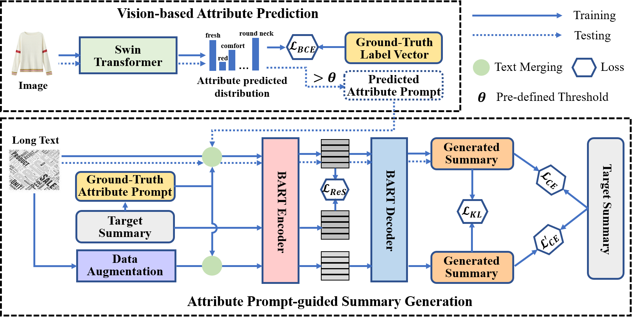
Method
Fig.1: The proposed V2P scheme.
Notes:
As shown in Figure 1, the proposed V2T consists of two key components: Vision-based Attribute Prediction, and Attribute Prompt-guided Summary Generation.

Slide 12
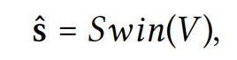
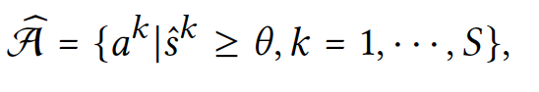
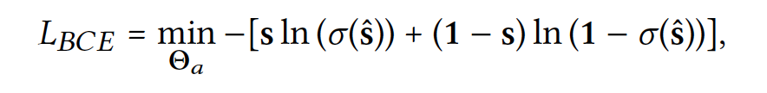
Method
Attribute Prediction
Notes:
To promote the multi-modal product summary generation performance by Generative Pretrained Language Models, we propose to extract the prominent semantic attributes of each product from its image and use their semantic embeddings to prompt the product summary generation
we implement our vision-based prominent attribute prediction component with the pre-trained Swin Transformer.
For the optimization, we use the ground-truth attribute label vector s to fine-tune the Swin Transformer with the binary cross-entropy loss.
Once this component gets well trained, we employ a threshold 𝜃 to determine the final predicted attributes.
ˈθreʃhoʊld

Slide 13
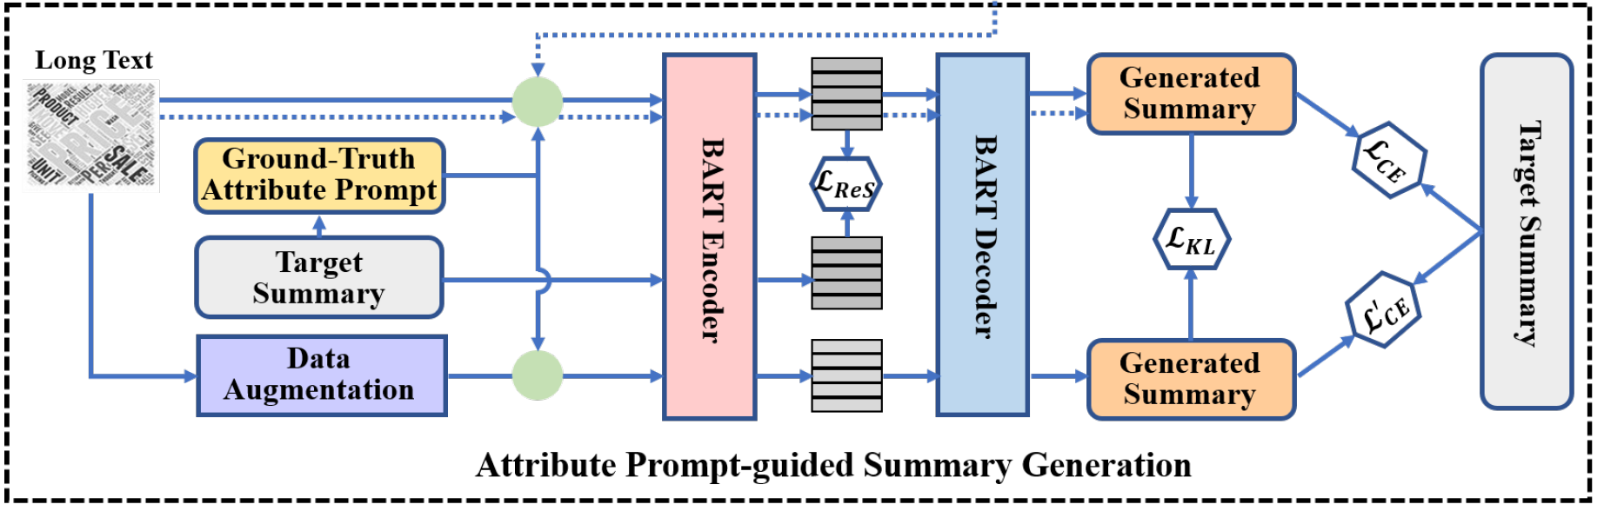
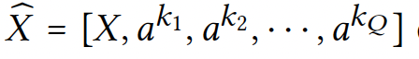
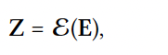
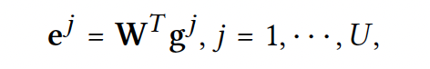
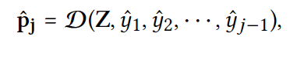
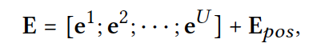
Method
Text and Attribute Prompt Embedding
BART-based Summary Generation
Notes:
For the second component, firstly, we introduce the embedding of the input, to avoid error accumulation, we employ the ground-truth attributes for training the second component of our model. Considering the long text description and attribute prompts come from the same token space, we directly treat them as a whole.
We then use the embedding layer of BART to encode the merged text modality of the product. and then get the final embedding E.
We then employ the pre-trained BART to fulfill the product summary generation.
In particular, we first feed the input embedding E into the encoder of the pre-trained BART. We then feed the encoded representation Z to the decoder of the pre-trained BART, which works in an autoregressive manner, namely, producing the next word by considering all the previously decoded outputs.

Slide 14
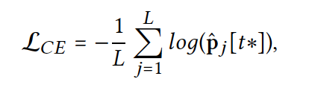
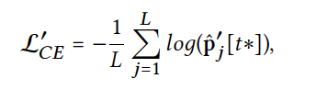
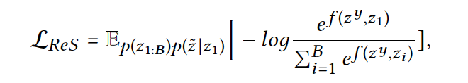
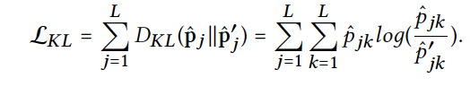
Method
Output-level and Representation-level Supervision
Data Augmentation-based Robustness Regularization
Notes:
To supervise the summary generation, we adopt the standard cross-entropy loss to fulfill the output-level supervision.
In addition, we maximize the mutual information between the input data and target summary, to capture the useful information of the input for the target summary generation. This is the representation-level supervision.
To deal with the diverse seller-generated long text descriptions of products, we resort to data augmentation, which works on deriving new and realistic-looking training samples from existing ones by altering their input. we also adopt the cross-entropy loss to supervise the summary generation for the augmented data and employ the KL Divergence to encourage the consistency between the generated summaries of the original and augmented data.
dɪˈraɪvɪŋ ˈɔːltərɪŋ

Slide 15
Outline
Background
Limitations
Experiment
Related Work
Method
Notes:
Now, we will detail the experimental section.

Slide 16
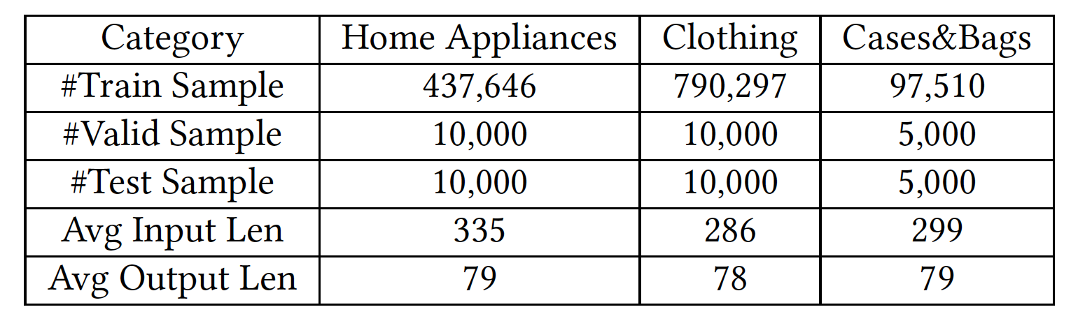
Experiment
Dataset
Table 1: Dataset statistics of CEPSUM.
Evaluation Metric
Rouge-1, Rouge-2, Rouge-L.
Notes:
In this work, we adopted the Chinese E-commerce product summarization dataset CEPSUM, which consists of around 1.4 million products covering three categories: Home Appliances, Clothing, and Cases&Bags.
To obtain the predefined attribute vocabulary, we first tokenize the dataset and perform the part-of-speech tagging. We then only retained the nouns and adjectives that have at least two Chinese characters to constitute the attribute vocabulary for each category. Notably, we built different attribute vocabularies for products of different categories, due to the fact that products of different categories tend to be summarized by different attributes.
And we employ three common evaluation metrics of text summarization tasks, Rouge-1, Rouge-2 and Rouge-L to evaluate our model.

Slide 17
Experiment
On Model Comparison
Table 2: Performance comparison among different methods.
Dataset/ Model | Home Appliances |  |  | Clothing |  |  | Cases&Bags
 | Rouge-1 | Rouge-2 | Rouge-L | Rouge-1 | Rouge-2 | Rouge-L | Rouge-1 | Rouge-2 | Rouge-L
Lead | 21.97 | 9.54 | 12.79 | 19.83 | 8.39 | 13.56 | 21.49 | 9.37 | 14.19
LexBank | 24.06 | 10.01 | 18.19 | 26.87 | 9.01 | 17.76 | 27.09 | 9.87 | 18.03
Seq2Seq | 21.57 | 7.18 | 17.61 | 23.05 | 6.84 | 16.82 | 23.18 | 6.94 | 17.29
MASS | 28.19 | 8.02 | 18.73 | 26.73 | 8.03 | 17.72 | 27.19 | 9.03 | 18.17
PG | 31.31 | 10.93 | 21.11 | 29.11 | 9.24 | 19.92 | 31.11 | 10.27 | 21.79
MMPG | 32.88 | 11.88 | 21.96 | 30.73 | 10.29 | 21.25 | 32.69 | 11.78 | 22.27
VG-Bart-1 | 32.71 | 11.46 | 22.87 | 31.36 | 9.94 | 21.34 | 32.73 | 10.26 | 22.44
VG-Bart-2 | 32.73 | 11.74 | 23.61 | 31.63 | 10.08 | 21.64 | 33.30 | 11.31 | 23.13
V2P | 34.47* | 12.63* | 25.09* | 35.05* | 11.98* | 22.62* | 34.65* | 11.89* | 24.53*
Improvement . ↑ | 4.84% | 6.32% | 6.27% | 10.81% | 16.42% | 5.06% | 4.05% | 0.93% | 6.05%
V2P consistently surpasses all the baselines, exhibiting the effectiveness of the proposed scheme.
Notes:
To verify the effectiveness of our V2P, we chose eight baselines. Table 2 shows the performance comparison among different methods with respect to different evaluation metrics. kəmˈpærɪsn
As can be seen from this table, the proposed V2P consistently surpasses all the baselines, which reflects the superiority of our V2P. suːˌpɪriˈɔːrəti
Our model achieves the largest improvement over the product category of Clothing. This may be due to that compared with the home appliances, cases, and bags, the visual modality of clothing products contains more straightforward cues of products, and effectively exploring it can largely improve the model performance.

Slide 18
Experiment
On Ablation Study
Table 3: Performance comparison between V2P and its derivatives.
Dataset/ Model | Home Appliances |  |  | Clothing |  |  | Cases&Bags
 | Rouge-1 | Rouge-2 | Rouge-L | Rouge-1 | Rouge-2 | Rouge-L | Rouge-1 | Rouge-2 | Rouge-L
V2P | 34.47 | 12.63 | 25.09 | 35.05 | 11.98 | 22.62 | 34.65 | 11.89 | 24.53
V2P-w/o-Image | 32.78 | 11.38 | 24.26 | 30.71 | 9.67 | 20.96 | 32.95 | 10.53 | 23.17
V2P-w/o-ReS | 33.74 | 11.73 | 24.64 | 34.81 | 11.67 | 21.76 | 33.77 | 11.11 | 23.48
V2P-w/o-Robust | 34.22 | 12.39 | 24.76 | 34.62 | 11.47 | 21.10 | 33.19 | 10.02 | 22.56
V2P-w-VGG | 32.90 | 11.67 | 23.92 | 34.31 | 11.60 | 21.07 | 33.46 | 10.99 | 23.72
V2P-w-Res | 33.15 | 11.90 | 24.12 | 34.49 | 11.67 | 21.13 | 19.44 | 4.58 | 13.34
V2P obtains the best performance, which verifies these components are significant in our model.
Notes:
To get a thorough understanding of our proposed model, we compared V2P with the following five derivations. .derɪ'veɪʃ(ə)n
As can be seen from Table 3, compared to the ablation method, the complete model obtains the best performance, which verifies these components are significant in our model.

Slide 19
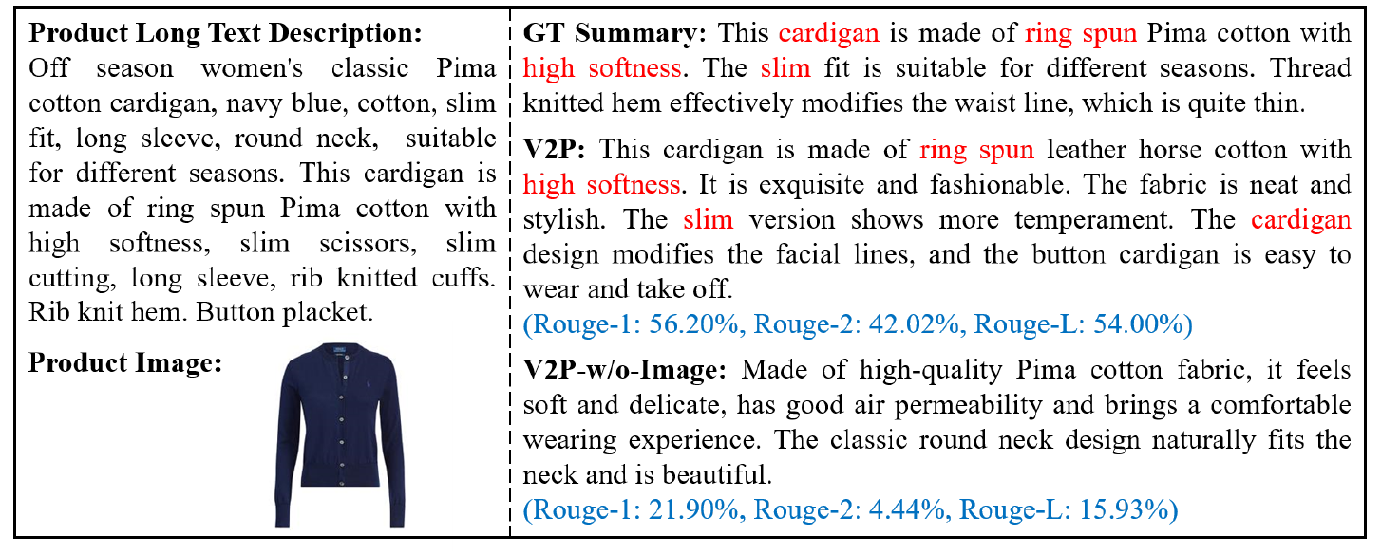
Experiment
On Case Study
Figure 2: Comparison between the summaries generated by our model and its variant V2P-w/o-image for a clothing product.
Notes:
Additionally, we show a testing result of our model and its variant V2P-w/o-image that generates the product summary only based on the given long text description.
As can be seen, the Rouge scores of our V2P are significantly higher than those of its variant V2P-w/o-Image.
Overall, these observations verify the practical value of our method.
. ˈveriəntˌˈværiənt . ˈveriəntˌˈværiənt observations
Looking into the generated summaries, we can learn that by incorporating the product’s image, our V2P is able to capture the product’s attributes, e.g., cardigan, right spun, high softness, and slim, while V2P-w/o-Image cannot. This intuitively demonstrates the necessity of considering the visual modality of the product. ˈveriəntˌˈværiənt

Slide 20
Conclusion
We design a vision-to-prompt based multi-modal product summary generation scheme, where the heterogeneous multi-modal data are unified in the same space by converting the vision modality into semantic attribute prompts.
We are the first to perform both output-level and representation-level supervision for MPSG simultaneously and introduce the data augmentation-based robustness regularization.
We are the first to adapt the generative pre-trained language model to solve the MPSG task and achieve superior performance on a real-world dataset.
Notes:
To sum up, in this work, first, we ….
ˌhetərəˈdʒiːniəs
ˌsaɪmlˈteɪniəsli
suːˈpɪriər

Slide 21

Thanks for your listening.
Codes are available!
Notes:
That is all about my presentation. Thank you for listening.
If you are interest with our work, you can find codes by the following QR code. If you have any questions, you can be free to ask.

